Slide 1

UP Domača špajza, d. o. o.
Offer locally grown food and products
Ekonomska šola Celje
Kosovelova ulica 4
3000 Celje
Slovenia
Gmail: spajzadomaca@gmail.com
Web page: updomacaspajza.weebly.com

Slide 2
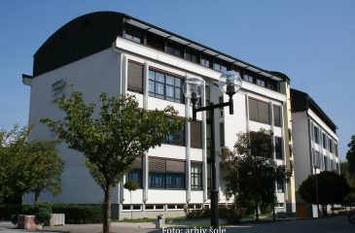
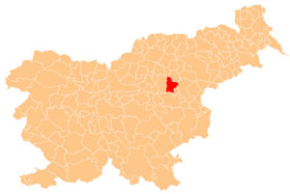
HOW TO REACH US
Our company is located at the School of Economics in Celje at Kosovelova ulica 4, 3000 Celje.

Slide 3


COMPANY DESCRIPTION
We are a learning company engaged in the sale of locally grown food and products.
Our company supports Slovenian farms and companies, so our offer consists exclusively of Slovenian products.
Quality and local production are very important to us, so we strive for organic processing.
OUR BUSINESS CARD:

Slide 4

OFFER DESCRIPTION
We cooperate with several farms engaged in organic production. We also work with farms abroad with an organic certificate. We replace our off-season crops with their products.
We employ local workers who have previously passed a test of knowledge in the field of handling organic products. We have an organic environmental daisy certificate.
Our products are therefore locally grown. In the future, we will increase our offer even more.
We swear by home-made products, so our slogan is: "Where it smells of homeliness".

Slide 5
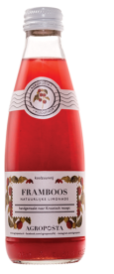




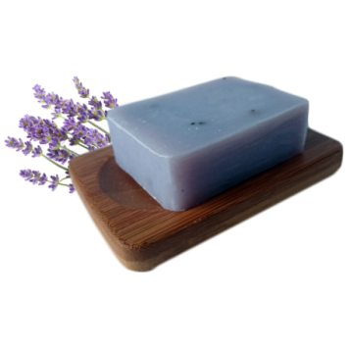



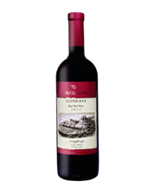
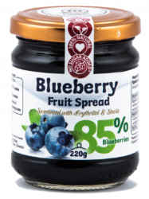

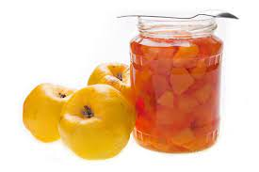
SORTIMENT
CANDLES
JUICE
FLOUR
LIQUEURS
PASTRIES
SOAP
OIL
GRANOLE
BASKETS
ALCOHOL
MILK
MARMALADE
COMPOTES

Slide 6
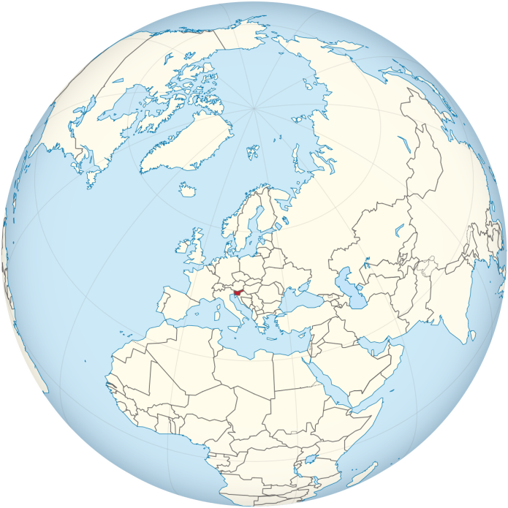
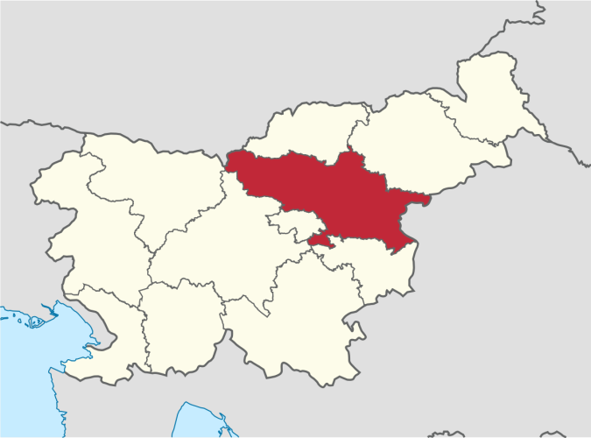
ORIENTATION OF THE SALES MARKET
We started offering our organically grown products at high schools in Slovenia. With the great hope that we will succeed in our market, we would then expand to a foreign market. We are currently concluding contracts with other learning companies, and in the future we will also try to connect with companies from abroad.
SLOVENIAN MARKET
PODJETJE | VREDNOST | %
UP TnesFit, d.o.o. | 275,80 € | 41,92
UP Baked, d.o.o. | 123,00 € | 18,69
UP Jezerski bazeni, d.o.o. | 76,40 € | 11,61
UP Tado, d.o.o. | 76,40 € | 11,61
UP My Way, d.o.o. | 71,95 € | 10,93
Ostala podjetja: | 34,45 € | 5,24
Skupaj vrednost: | 658,00 € | 100%

Slide 7
COMPETITION
Our competition is not big, although a few companies are engaged in food sales. One of our major advantages is that we support locally and cooperate with local farms and providers from different parts of Slovenia.
Our indirect competitors, given that no company offers locally organically grown food and products, are:

Slide 8




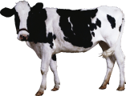

SALES POTENTIAL
We cover 14.25% of customers on the Slovenian market.
POSITIONING
We want our customers to recognize us as an ecological and reliable company.
In the minds of our customers, we want to direct our product as a home-made, healthy and tasty product of organic production.

Slide 9
PROMOTIONAL PLAN
Our home-made products are of the highest quality, made from locally sourced ingredients.
Product prices range between € 2.00 and € 15.00.
Instagram
Facebook
Web page
online shop
Catalog
Business card
Folder
Advertising video
Radio ad
Leaflets

Slide 10
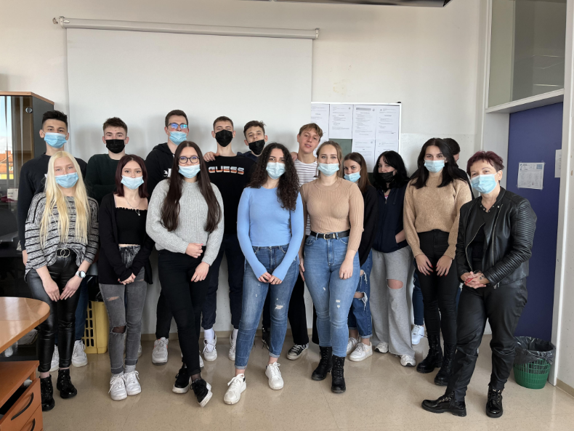
TEAM DOMAČA ŠPAJZA
The company currently has 15 employees. The structure of employees is as follows:
The need for future staff will be in the field of sales. We will employ a person with the 5th level of education in the field of economic technicians. The candidate must be reliable, communicative, responsible and have a team spirit.

Slide 11
FINANCIAL PLAN
To start the company, each partner invested € 50,000.00 in equity.
We currently manage all costs ourselves.
We expect to cover all costs by producing 1,500 products.
Breaking point = = = 1.500
FC
p - AVC
30.000 €
35 - 15

